Slide 1
Week 7
Race
Learning Outcomes
Service Learning:
Ethnic Studies: 1.
Area D:
What is Racism?
Laws Supporting Racism
Economic inequality
Housing discrimination/Segregation
Notes:
The goal of these next few slides is to assess how well versed students are on this topic. In other words, we need to help them unlearn first.

Slide 2
What is Racism?
Notes:
The goal of these next few slides is to assess how well versed students are on this topic. In other words, we need to help them unlearn first.

Slide 3
Definitions of racism
………………………………………..
Racism = prejudice + power
Racism is about placism
Racism assumes the human world is naturally divided into distinct racial caste groups.
The racial caste groups explain the inequality while also justifying the continuing discrimination that perpetuates said inequality
EXAMPLE: There is no violation of a higher law if whites prevent blacks from home ownership because whites are a better fit for homeownership because they are naturally more responsible people.
Notes:
Causes of racism. Fear

Slide 4
Racism and Placism
………………………………………..
Social Inequality came first.
Racism came after to justify the inequality.
“Our new government is founded upon...the great truth that the negro is not equal to the white man; that slavery subordination to the superior race is his natural and normal condition.”
Vice President Alexander Stephens of the Confederacy, 1861
“The only good Indian is a dead Indian.”
General Philip Sheridan, 1869
Thus RACISM is about putting people in their supposedly PROPER PLACE (considered to be consistent with nature).

Slide 5
Racism is also a social fact
………………………………………..
“All civilizations derive from the white race.”
“civilization...will certainly die...when...swamped by the
influx of foreign elements.”
Arthur de Gobineau (1853)
What the Melting Pot actually does in practice, can be seen in Mexico, where the absorption of the blood of the original Spanish conquerors by the native Indian population has produced the racial mixture which we call Mexican, and which is now engaged in demonstrating its incapacity for self-government.
Madison Grant (1916)
“posed the greatest threat to
Western Civilization and the White Race.””
Lothrop Stoddard (1920)

Slide 6
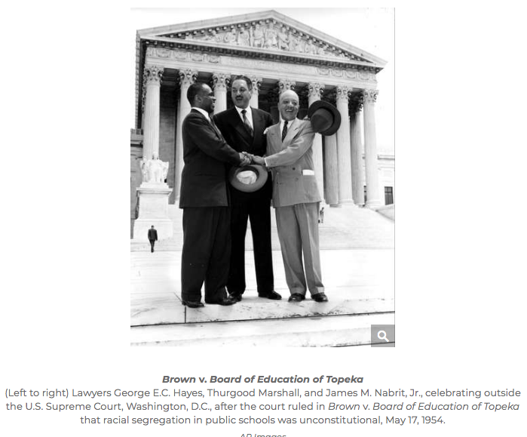

Slide 7
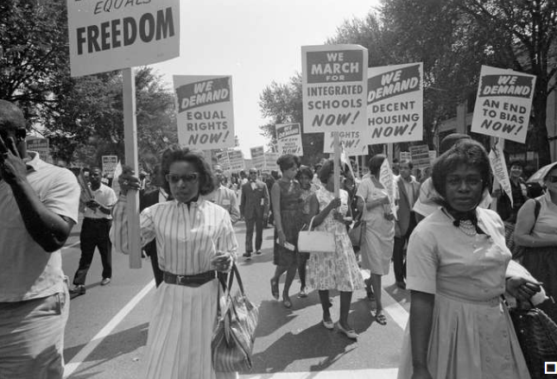
Civil rights movement: March on Washington
Civil rights supporters carrying placards at the March on Washington, D.C., August 28, 1963.

Slide 8
Back to Placism (Racism and Placism)
………………………………………..
Placist = Person who descriminates based on where other people live
Class examples?

Slide 9
Why does racial inequality exist?
There’s an old saying
In Europe, labor was cheap, but land was expensive.
In America, land was cheap, but labor was expensive.
Different groups arrived in the United States by the boatload
to fill particular niches in the labor market.
………………………………………..
Africans were abducted and brought to the South (as well as the Caribbean and Brazil) to harvest sugar, tobacco, and cotton.
After the abolition of slavery, Chinese, Indians, and other Asians became a new source of cheap labor in agriculture and mining.
Europeans migrated by the tens of millions to work in urban factories.
Mexicans had their land stolen in 1848, but since 1924 became an easy source of cheap agricultural labor after Asian immigration curtailed.

Slide 10
Laws Supporting Racism

Slide 11
Race and the Law
………………………………………..
Naturalization laws made clear that American citizenship would be tied to racial identity for the nation’s first 160 years.
1790: “That any alien, being a free white person, who shall have resided within the limits and under the jurisdiction of the United States for the term of two years, may be admitted to become a citizen thereof.
1870: “And be it further enacted, That the naturalization laws are hereby extended to aliens of African nativity and to persons of African descent.”
1952: “The right of a person to become a naturalized citizen of the United States shall not be denied or abridged because of
race or sex or because such person is married.”

Slide 12
Compromise preserved civility for whites,
but delayed justice for blacks
……………………………………………….
The Missouri Compromise of 1820
One slave state for every free state joining the Union in order to preserve balance of power in U.S. Senate
The Compromise of 1850
Adding states to the union on the condition their people get to choose whether to allow slavery or not
The Fugitive Slave Act of 1850
Requires all judges to assist with capture and return of escaped slaves, by taking white men at their word
The Kansas-Nebraska Act of 1854
Created territories of Kansas and Nebraska and allowed them to vote on whether to allow slavery or not
The Dred Scott Supreme Court decision of 1857
Declared that slaves were property not U.S. citizens
Notes:
Statement A adopts a libertarian perspective that prioritizes individual freedom regardless of ends or costs. They believe that freedom is so sacrosanct as to trump all other virtues.
Statement B adopts a utilitarian perspective that prioritizes a cost/benefit analysis of where free market principles must be set aside during an emergency because it does more harm than good in this situation.
Statement C adopts a humanist perspective that believes that seeks to promote virtue by shaming price gougers for their greed and passing anti-gouging laws so extreme price increases don’t happen during emergencies.

Slide 13
Appeasing the South in the 20th Century
……………………………………………….
Until the 1980s, the Democratic Party was the party of the south, and thus the party was inherently conflicted by its more progressive northern wing and its racist southern wing.
In the 1930s, Southern Democrats demanded that blacks be excluded from Social Security by barring people in agriculture and domestic service.
Jim Eastland, chair of Senate Judiciary Committee from 1957-1978, opposed all civil rights legislation on the racist rationale that segregation promotes racial harmony because everybody knows their place in society..
Lyndon Johnson had to remove voting rights from the 1964 Civil Rights Act before Congress would vote on it. Luckily, he brought back voting rights to the table after he won the election fo 1964.
Notes:
Even at the beginning of American republic, blacks were a significant percentage of the population, especially in the South. Delaware and Maryland were originally slave states, but banned the practice much sooner than the states of the Old South.

Slide 14
The Asian American Success Story
………………………………………..

Slide 15
The Asian American Success Story
………………………………………..
What this means for social justice:
The myth of Asian success provides a powerful pretext for dismantling reforms of the 20th century..
The myth of Asian success means Asians are not getting the counseling they need because people assume they’re doing fine.
Anti-Asian discrimination emerges when Asians are “too successful” and taking away opportunities from “real Americans.”
If the success myth is more or a matter of passing on intergenerational wealth and privileges, what are we going to do help people at the bottom who don’t have these in abundance?

Slide 16
SKIPThe Asian American Success Story
………………………………………..
Are Asian Americans really a model minority whose overperformance anyone can be emulated, or are there other circumstances beyond one’s control?
The systemic explanation:
Most Asian Americans are immigrants or only a generation or two removed, and since 1965, these immigrants are middle to upper class because of our laws that favor that type.
Thus Asians are more likely to be successful because most did not start at the bottom when they got here.
Asians have more workers per family and tend to live in metro areas, which explains higher family income.
Asian includes 25 nationalities that don’t share a common language or religion or cuisine, so it’s hard to pin down what Asian culture is.

Slide 17
Class Discussion: What is being done to help alleviate racism? What is being done to perpetuate racism

Slide 18
Economic Inequality
Notes:
The goal of these next few slides is to assess how well versed students are on this topic. In other words, we need to help them unlearn first.

Slide 19
Why are blacks still so poor?
……………………………………………….
The Structural Explanation
Blacks were enslaved for over 250 years, which means subjection to family separation, labor exploitation, and physical violence.
Blacks were not universally granted the right to vote until the 1965 Voting Rights Act, which meant white politicians did not have to worry about their needs or fear election day reprisals.
Even reforms of the 20th century were watered down by Southern politicians who were opposed to blacks receiving benefits from the New Deal or the Great Society.
Labor unions helped expedite the passage of many people into the middle class, but routinely excluded Blacks and Asians.
Notes:
Even at the beginning of American republic, blacks were a significant percentage of the population, especially in the South. Delaware and Maryland were originally slave states, but banned the practice much sooner than the states of the Old South.
New Deal was a series of programs, public work projects, financial reforms, and regulations enacted by President Franklin D. Roosevelt in the United States between 1933 and 1936. It responded to needs for relief, reform, and recovery from the Great Depression.
The Great Society was a set of domestic programs in the United States launched by Democratic President Lyndon B. Johnson in 1964–65. The main goal was the total elimination of poverty and racial injustice.

Slide 20
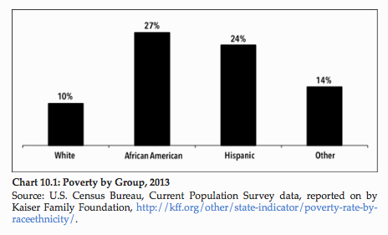
Economic inequality tends to fall along racial lines.
This chart shows U.S. poverty rates.
………………………………………..

Slide 21
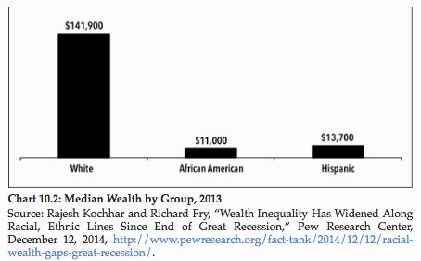
Income + Assets = Wealth.
An enormous racial wealth gap exists in America.
………………………………………..
Notes:
The military draft has historically recruited soldiers from the lower end of the socioeconomic spectrum. They have fewer job options outside of the military, but just as importantly, they have fewer connections and resources with which to contest their conscription.
College admissions favors those with money. Elite college admissions those with extremely wealthy parents who attended or donated to the school in question.
Law firms, especially the elite ones, operate as extensions of high society clubs because they want their rich clients represented by lawyers from the same socioeconomic background. A degree from one of a handful of institutions is required to get one’s foot in the door. All others need not apply regardless of skills.
Since 1934, the federal government has played an active role in civil rights, but its participation in the housing market has actually worsened housing inequality.

Slide 22
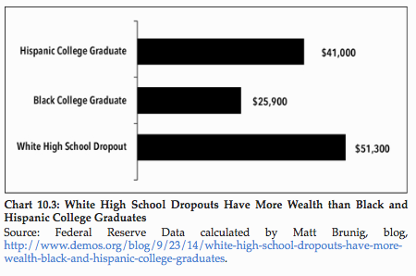
We know it falls along racial lines because even uneducated whites have an edge over educated blacks.
………………………………………..
Notes:
The military draft has historically recruited soldiers from the lower end of the socioeconomic spectrum. They have fewer job options outside of the military, but just as importantly, they have fewer connections and resources with which to contest their conscription.
College admissions favors those with money. Elite college admissions those with extremely wealthy parents who attended or donated to the school in question.
Law firms, especially the elite ones, operate as extensions of high society clubs because they want their rich clients represented by lawyers from the same socioeconomic background. A degree from one of a handful of institutions is required to get one’s foot in the door. All others need not apply regardless of skills.
Since 1934, the federal government has played an active role in civil rights, but its participation in the housing market has actually worsened housing inequality.

Slide 23
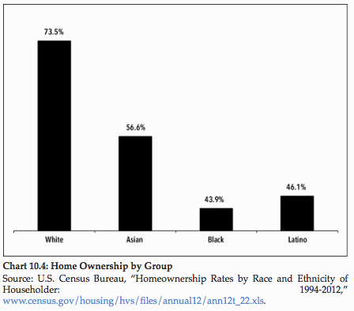
On average, Asian Americans have the highest family income, but still lag behind whites on wealth.
………………………………………..

Slide 24
Why does racial inequality still exist?
Desire to be around those who are like you
Preserve wealth and power that has been consolidated

Slide 25
Segregated Housing

Slide 26
The Segregated Housing Market
……………………………………………….
In exploring inequality, we must look at both the individual and the systemic reasons for why this inequality exists.
Racially restrictive covenants that required homebuyer to promise to never rent or sell to minority groups.
2. Federal government programs that favored investment in white neighborhoods while redlining black neighborhoods.
3. Federal programs and real estate agents punished individuals for bucking the system in order to integrate neighborhoods.
4. Subprime mortgages often preyed on people of color.

Slide 27
Racially Restrictive Housing Covenants
……………………………………………….
The creation of all-white neighborhoods through covenants stipulating who can own or rent the property.
“That the premises herein shall not, nor shall any part thereof, nor any estate or interest therein or any improvements thereto, at any time, be sold, conveyed, leased or transferred to or permitted to be occupied or used by Asiatics, Negroes, or any person born in the Turkish Empire nor any lineal descent of such person, except that persons of said races may be employed as household servants.”
“That no transfer, lease, possession, use or occupancy of said lot shall ever be made or given to any one other than a person of the Caucasian or white race, except that persons of such excluded races may be employed as household servants.”

Slide 28
Maps of Racially Divided Areas
Redlining Richmond
Redlining Austin TX. Need to scroll down to map
Redlining Albany
In readings?
What is blockbusting
Racial Zoning Laws
Inflated Mortgages/property tax
Suppressed Incomes
Case for reparations/context Japanese reparations

Slide 29
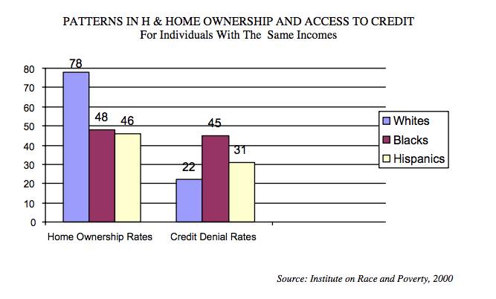

Slide 30
1. Richard Rothstein’s book focuses on how state action contributed to racial segregation in America. From a justice standpoint, why is state-based discrimination worse than racial discrimination in the private sphere? Come up with utilitarian, freedom-based, and virtue-based arguments. ESO3
2. Tell us about some of the individuals who were denied housing on account of race. What are their stories? What are some of the more egregious accounts you read? ESO1
3. What more could the middle class African Americans in this reading have possibly done to qualify for housing in a white neighborhood? ESO2
4. The argument in favor of housing discrimination is both utilitarian (best interests of the community) and freedom-based (freedom to sell to whom you choose). How would you make an argument against discrimination? Do you use utilitarian, freedom, or virtue-based arguments?
5. What was worse, the racial caste system of the Jim Crow South or the racial apartheid of the housing market outside of the South? ESO3
6. If reparations for African Americans were really on the table, what should it entail? For reference, every Japanese survivor of the internment camps received a $20,000 check from the U.S. government. ESO4

Slide 31
SKIPThe Asian American Success Story
………………………………………..
Are Asian Americans really a model minority whose overperformance anyone can be emulated, or are there other circumstances beyond one’s control?
The individualist explanation:
Asians value education more than most other groups do.
They’ve succeeded because our system rewards hard work.
Asians face discrimination but they don’t let it get in their way.
Less successful groups should follow this model instead of claiming
the system is unfair.
Notes:
The military draft has historically recruited soldiers from the lower end of the socioeconomic spectrum. They have fewer job options outside of the military, but just as importantly, they have fewer connections and resources with which to contest their conscription.
College admissions favors those with money. Elite college admissions those with extremely wealthy parents who attended or donated to the school in question.
Law firms, especially the elite ones, operate as extensions of high society clubs because they want their rich clients represented by lawyers from the same socioeconomic background. A degree from one of a handful of institutions is required to get one’s foot in the door. All others need not apply regardless of skills.
Since 1934, the federal government has played an active role in civil rights, but its participation in the housing market has actually worsened housing inequality.

Slide 32
Potential Discussio
Suppressed incomes
Placism
Property Tax and Prejudice
Predatory Loans
Systemic Racial Descrimination
Housing Discrimination

Slide 33
Meet with Your Group/Zoom Breakout Room
.....................................................................
Form group roles: Moderator, Researcher, Documenter.
Find an artifact in media, such as an article, website, or social media post, that relates to this week’s topic. Explain how it relates to the class topic and discussion and provide some kind of comment.
What is your reaction on this source? Do you agree or disagree. Is it accurate or inaccurate?
What are potential biases behind the stance?
Report to class.
Post individually in forum titled In-Class Activity and include a screenshot or link to your artifact.
Notes:
When lecturing, you have start with the big reveal then work backwards. Sandel started with an anecdote before he got to his point. We will have to cut to the chase from the get go.

